Slide 1
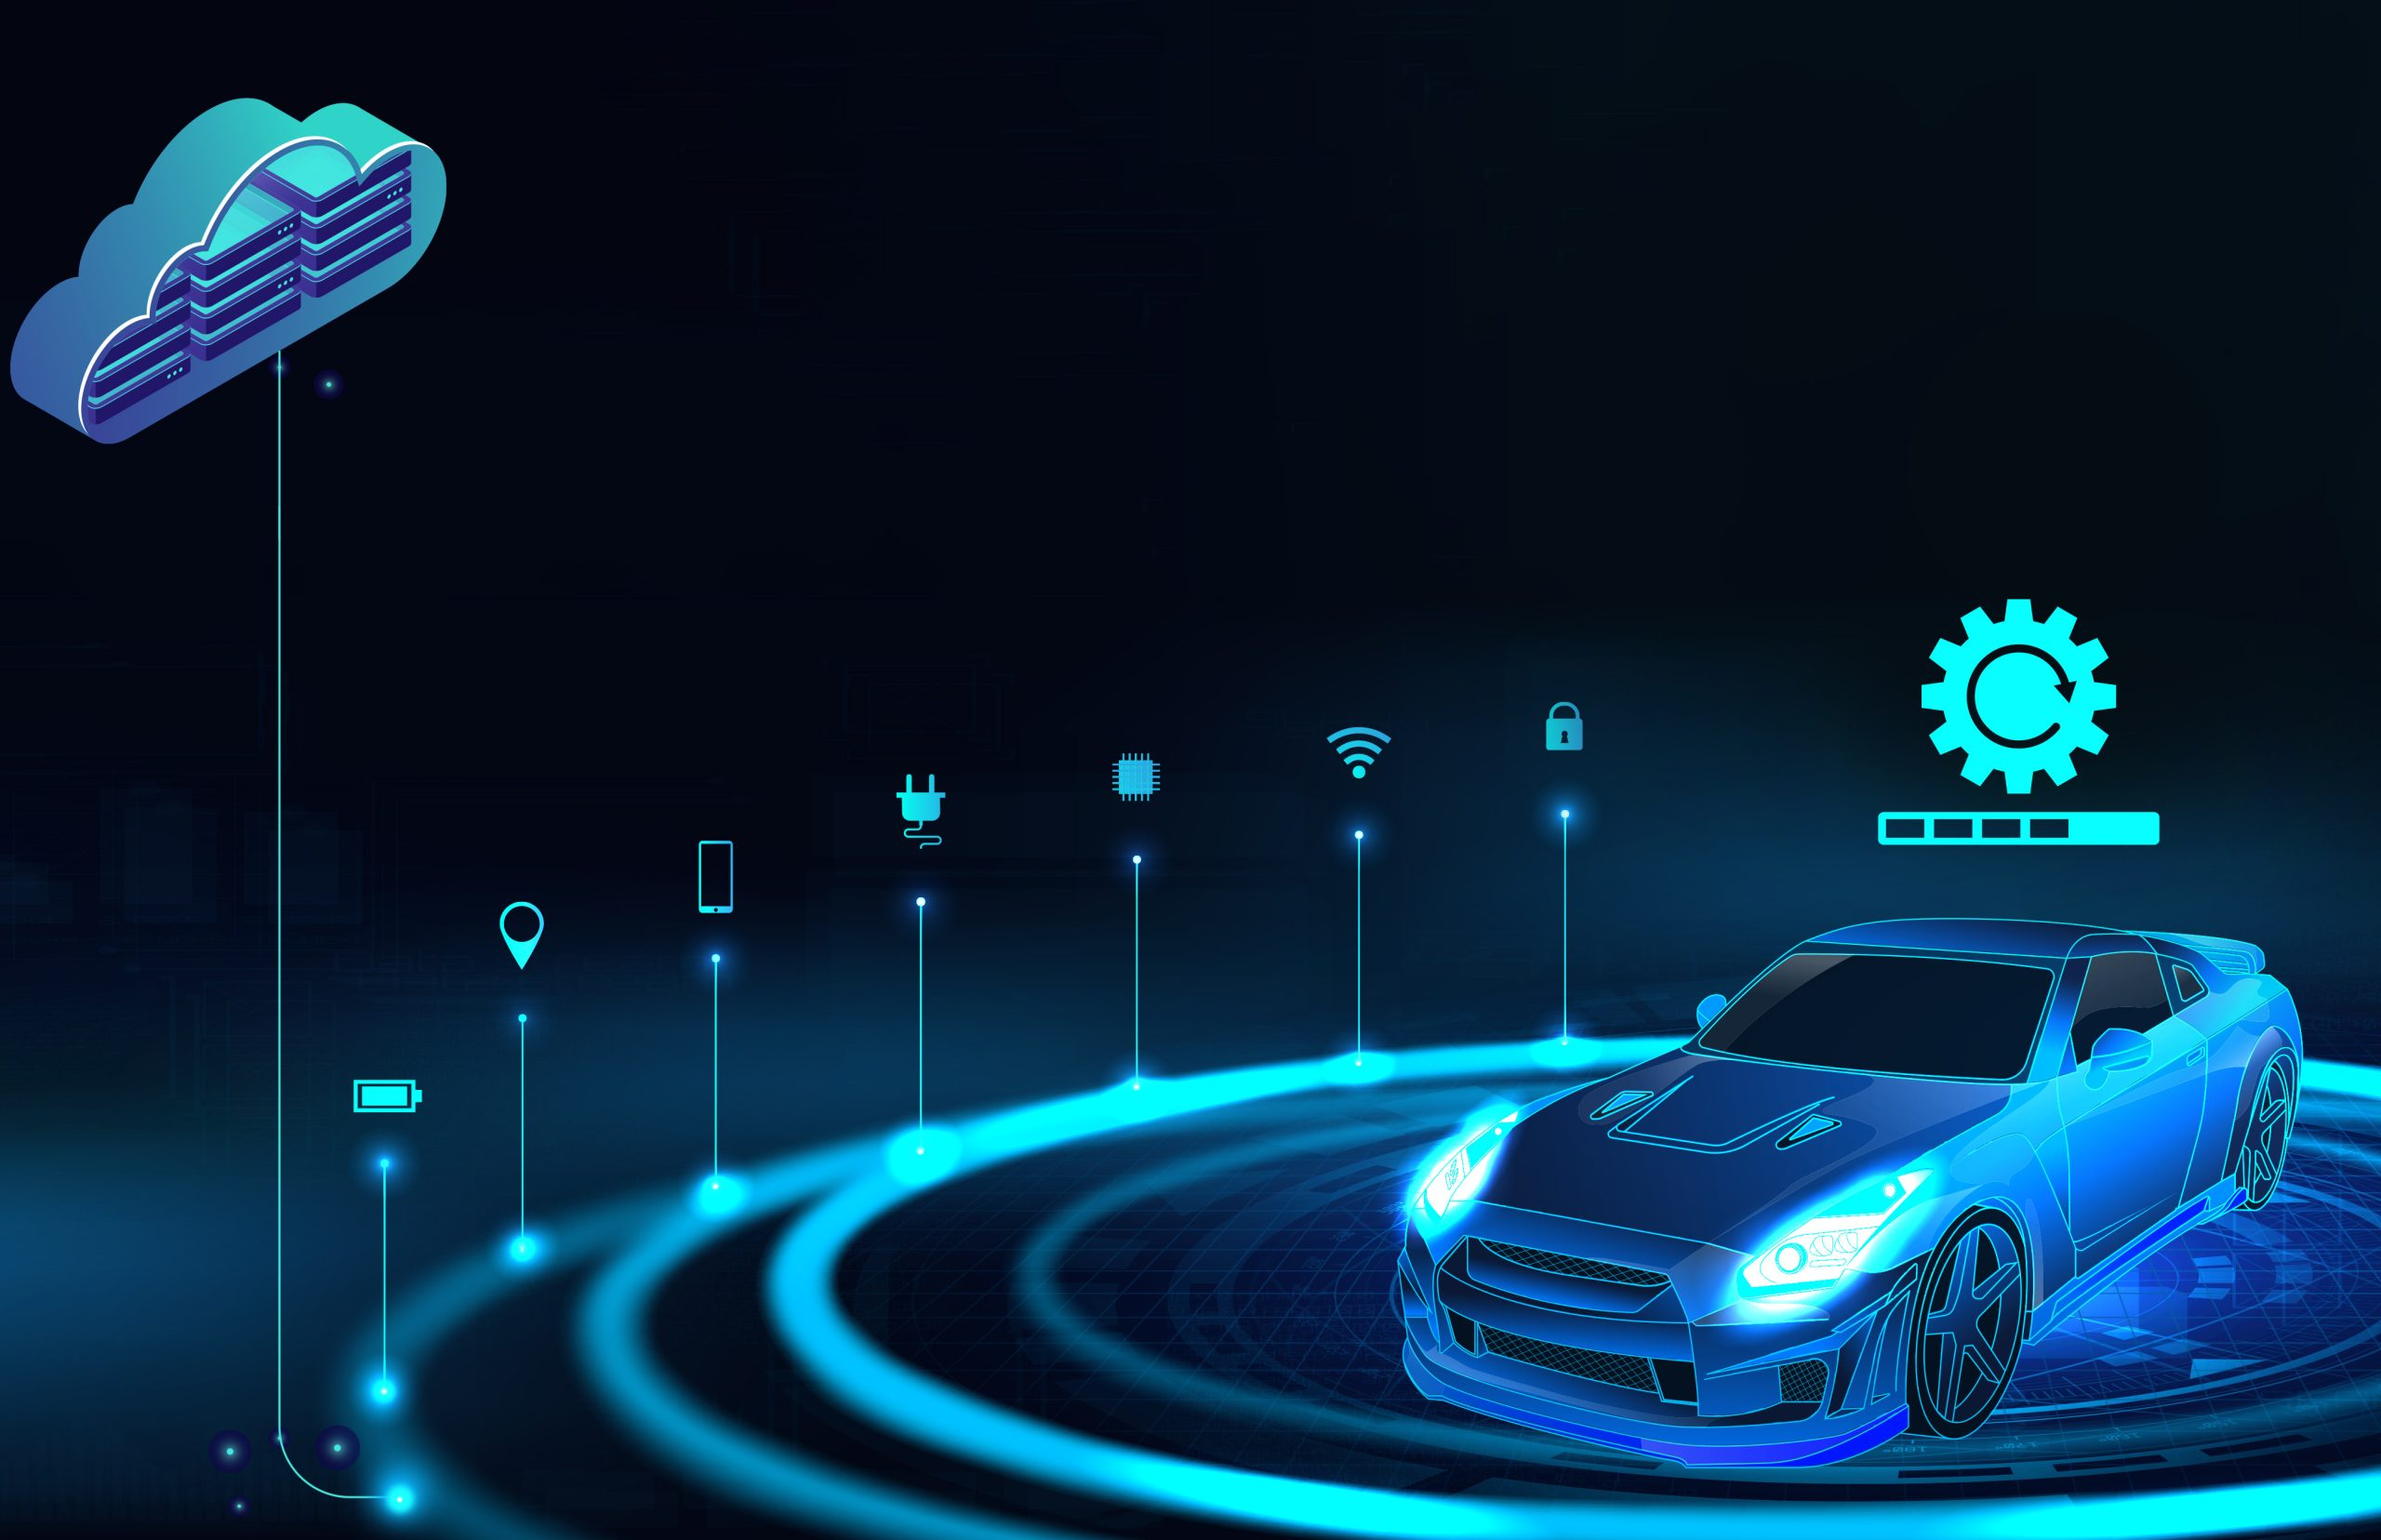
FOTA
(Firmware Over –The Air)

Slide 2
Team Members
Abdulrahman Khalaf
Abdulrahman Tarek Mohamed Saad
Aya Ahmed Samir Abbas Halawa
Seba Ammar
John Emile Fikry Megalaa
Ziad Mohamed Samir Gomaa

Slide 3
Agenda:
Why FOTA?
How it Works?
Bootloader.
GUI and Server.
Application and PCB Design .
Challenges.
Future Work.
Market Opportunity.

Slide 4
Why FOTA?

Slide 5
Why FOTA?
Vehicles nowadays are almost based on software this leads to a huge number of ECU’s present in the vehicle and million lines of code.
There is a challenge to fix a bug or update a new software.
What is the solution? Similar to mobile phones and PC’s the solution is
Remote software update

Slide 6
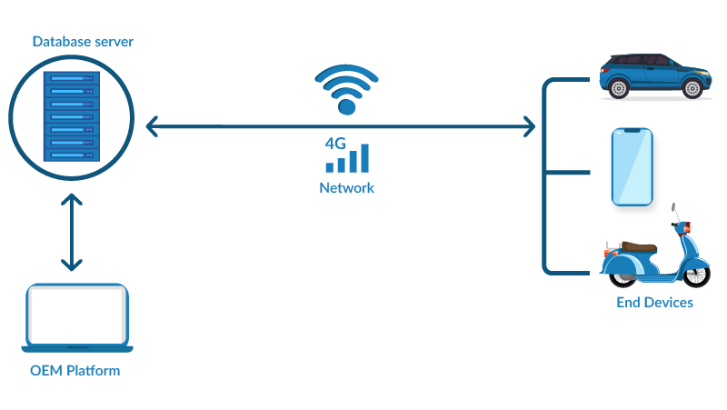
Why FOTA?
FOTA
Allow OEM’s to remotely update their new software.
Bug fixing through software update.

Slide 7
How it Works ?

Slide 8


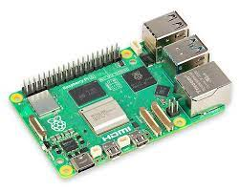

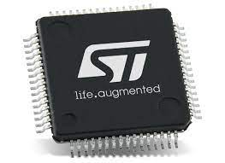
How it Works?
Server
HMI System
Raspberry pi
UART
Stm32F401CC

Slide 9
Demo video

Slide 10
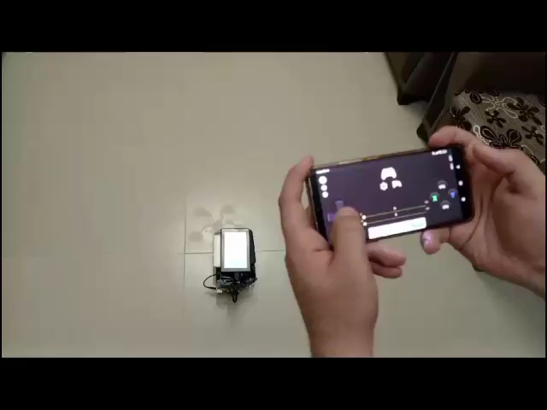
How it Works?
Server
HMI System
Raspberry pi
UART
Stm32F401CC

Slide 11
Bootloader

Slide 12
Bootloader
App
Hex_parser
Software modules:
GPIO
System tick
UART
Flash Driver
Hex_parser
Complex Driver
HAL
LED , Switch
Std_types , Bit_Math
MCAL
GPIO , System tick , Fls , UART

Slide 13
Booting Sequence
Bootloader Version 1
8 sec
Data
start
Timer
Rx Data ?
Stop timer
Parsing
No Data
8 sec
Run App
Reset

Slide 14
Bootloader Version 2
App
Server
Bank 1
Bank 2
App

Slide 15
Bootloader Version 3
Bank 1
Bank 2
App
Server
App
App
`
App
App
Check Sum

Slide 16
GUI and Server

Slide 17

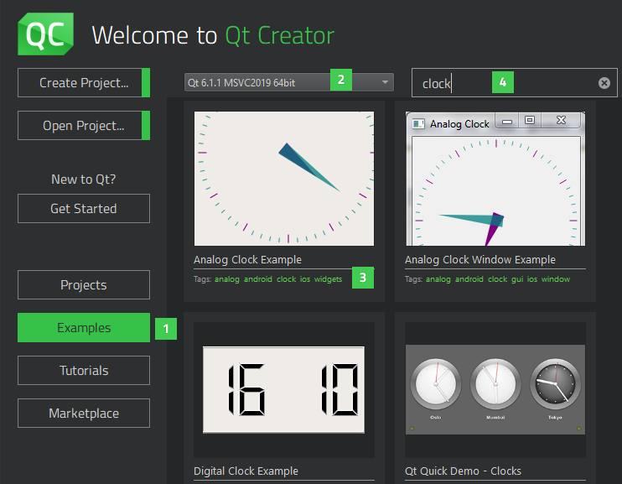
How we Designed and implemented GUI FOR THE USER
Program was designed and implemented using QT Designer allows you to create user interfaces (UIs) for Qt applications without writing any code. It provides a drag-and-drop interface for adding widgets to your UI and setting their properties.

Slide 18
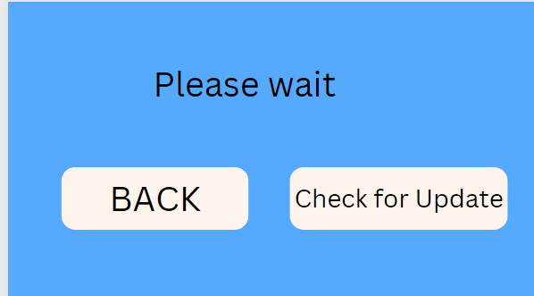
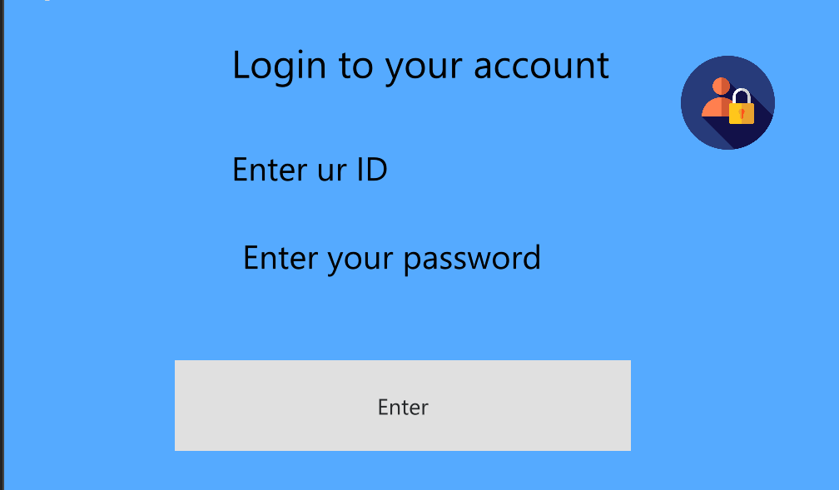
We cared about UI design
We designed a UI to easy and flexible

Slide 19
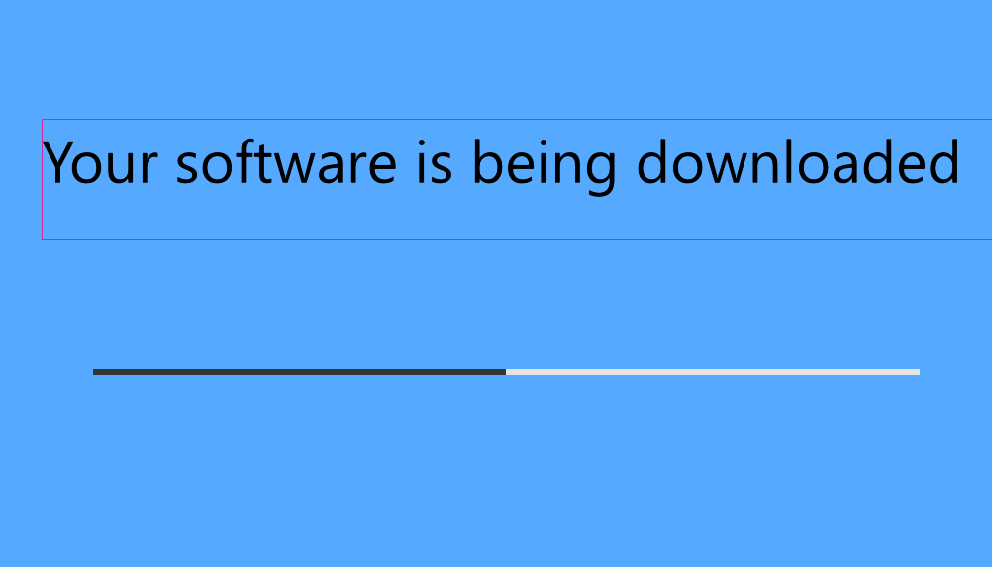
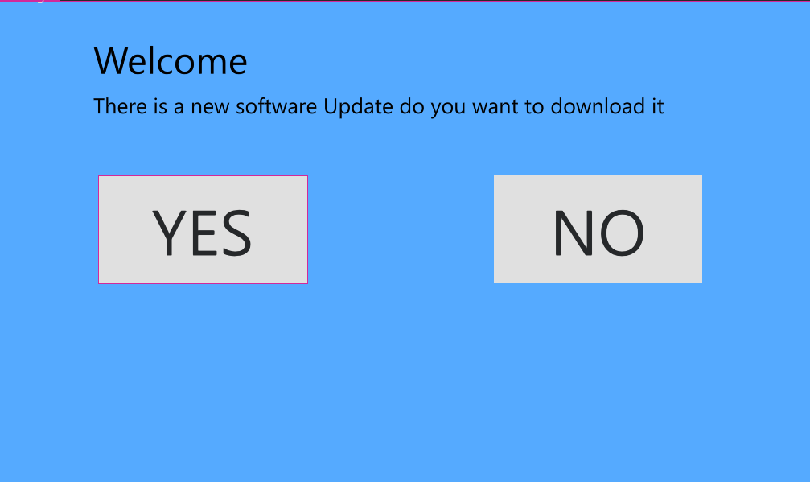
The follow From authentication page Reaching the progress bar
As we are working mainly on downloading FOTA we focused on functional and non-functional properties

Slide 20
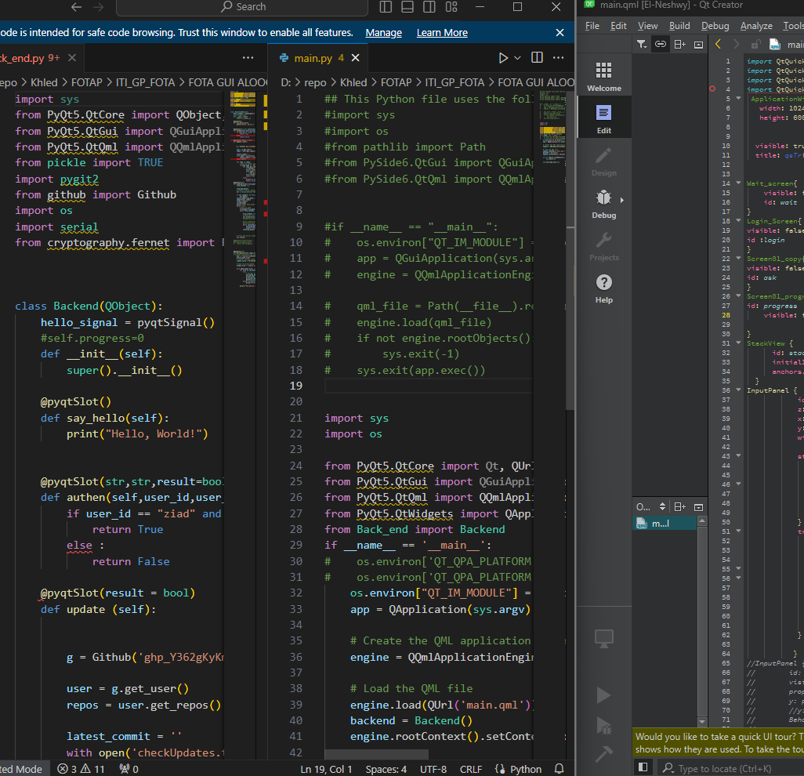
How it works
Login Service > Start.sh > Main.py > Main.qml
Authentication > Check_Update.py > Download file from GitHub server and decrypt
Question > Send_uart.py

Slide 21

How Admin GUI works
We designed the admin Control program using Tkinter to have high performance

Slide 22
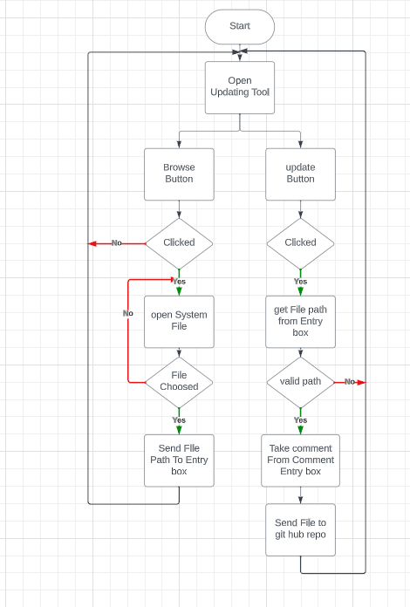
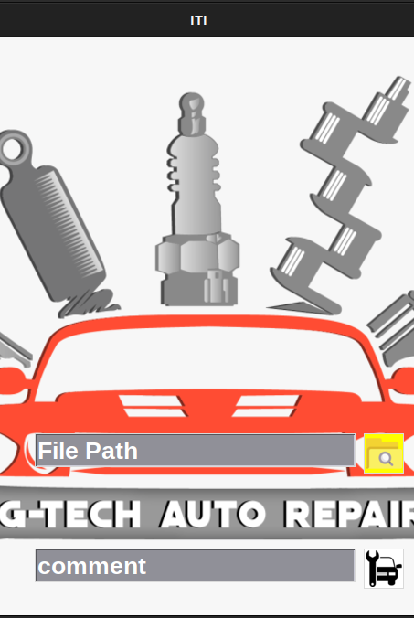
How it works

Slide 23
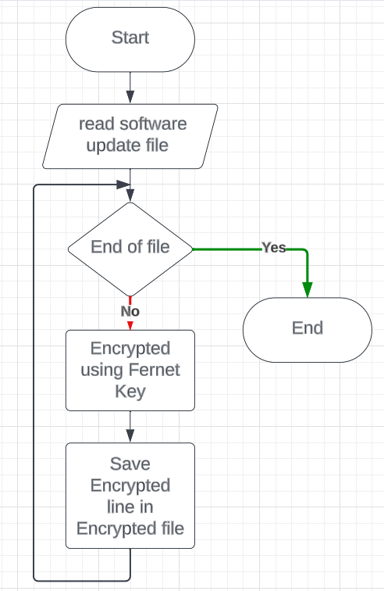
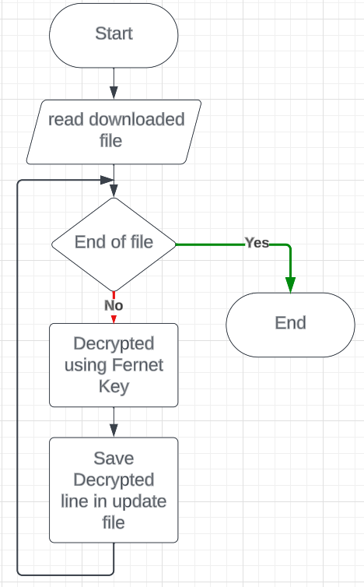
Encryption and decryption Flowchart

Slide 24
Applications and PCB Design

Slide 25
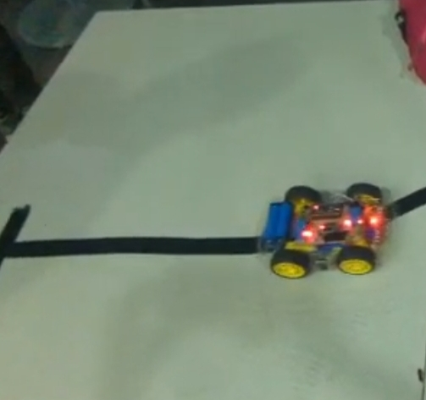
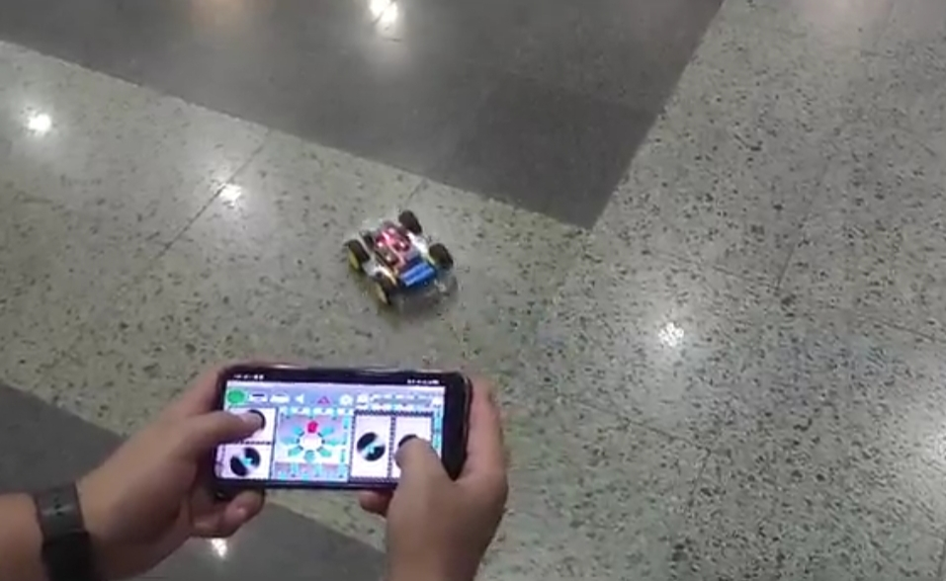
Two mode
Line follower mode
Controlled via Bluetooth

Slide 26
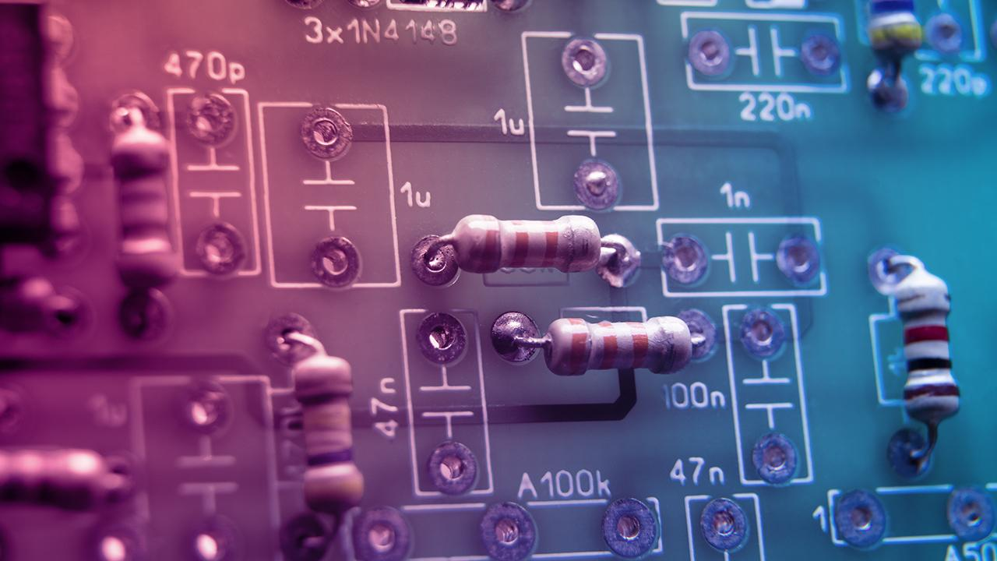
PCB design

Slide 27
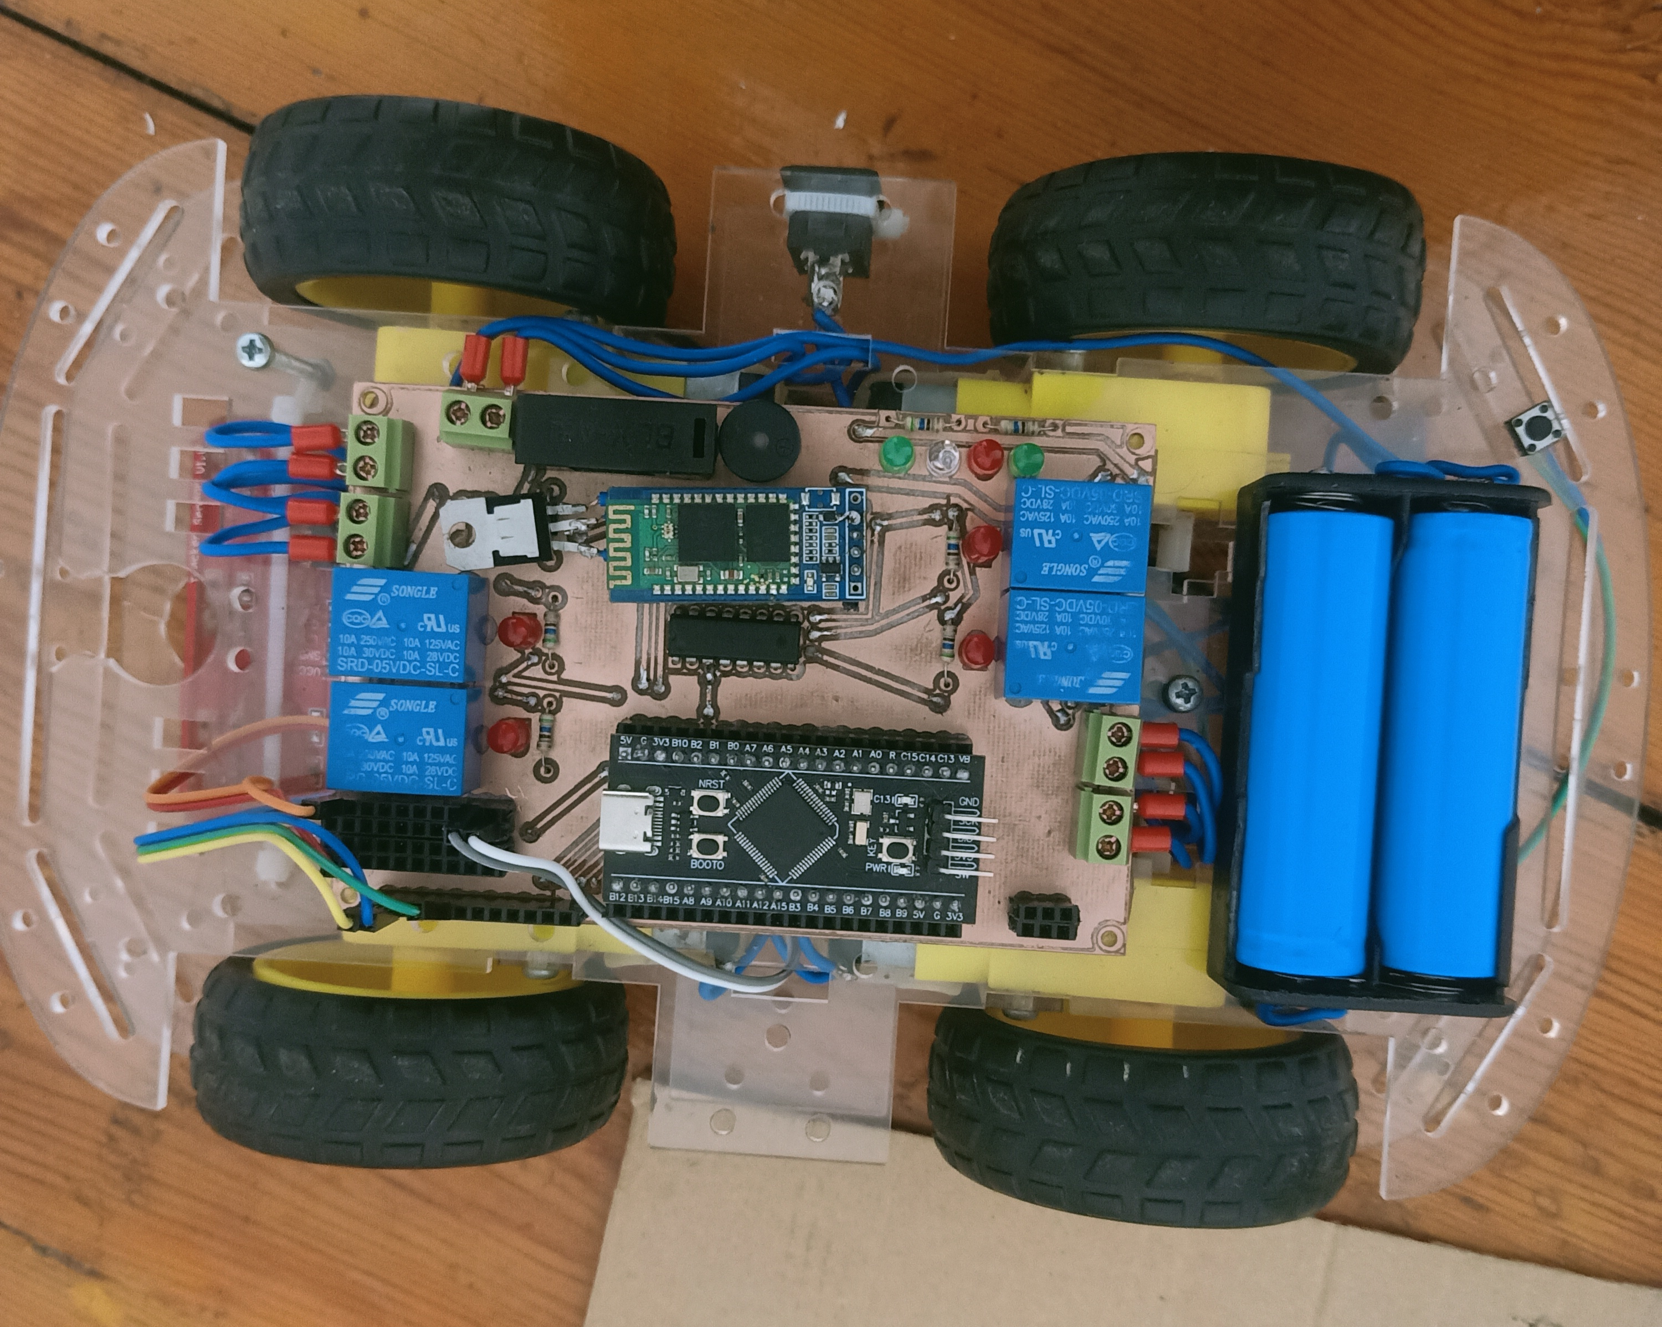
Prototype without HMI

Slide 28
The Challenges

Slide 29

The Challenges
ENTRY POINT
LINE FOLLOWER SPEED
Add offset
Use half capacity
of battery

Slide 30
Future Work

Slide 31
Future Work
Getting Real-Time Diagnostics
Firmware Version Rollback
Seamless FOTA
Using CAN Communication Protocol
Delta File

Slide 32
Market Opportunity

Slide 33
Market Opportunity
FOTA is used in multiple industries like:
1. Consumer electronics
2. Automotive
3. Industrial
Target Market is Automotive

Slide 34
Any Questions?

